Slide 1
Tuple Relational Calculus
Dr. T. Joshva Devadas
Professor
SCOPE

Slide 2
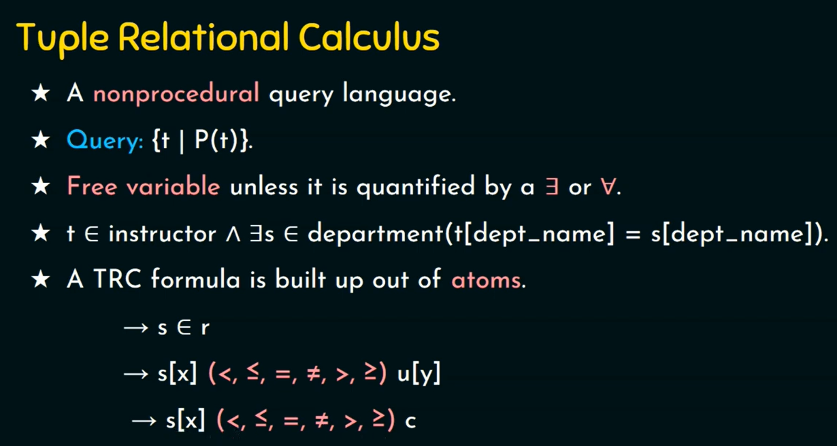

Slide 3
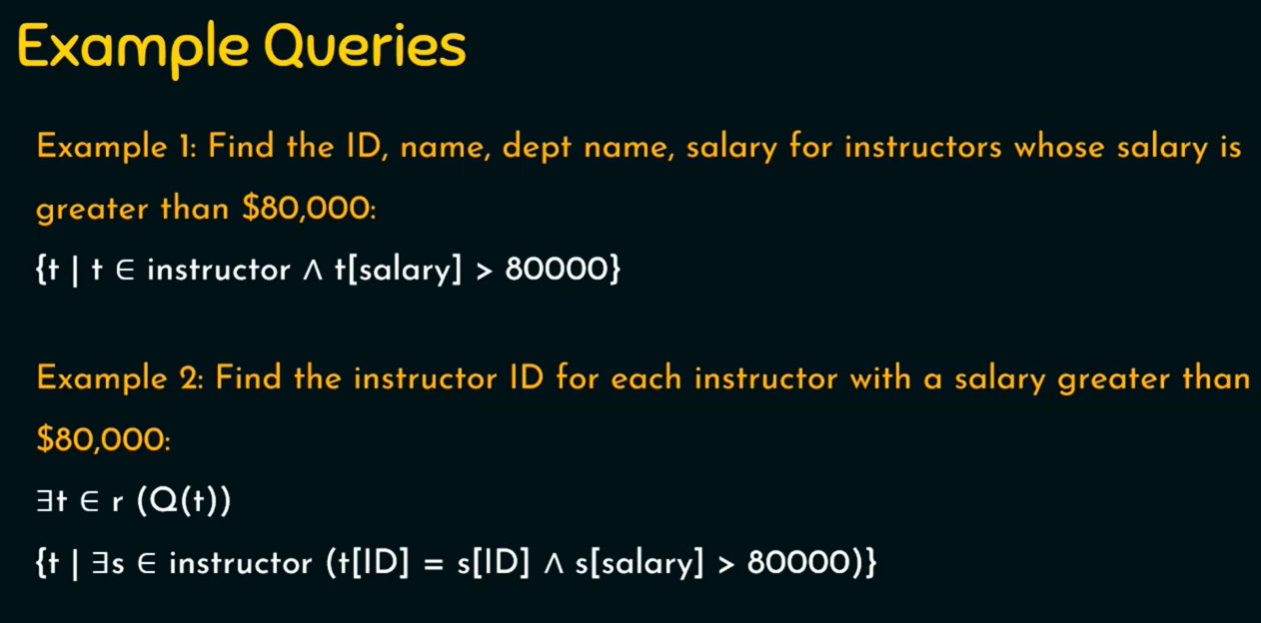

Slide 4
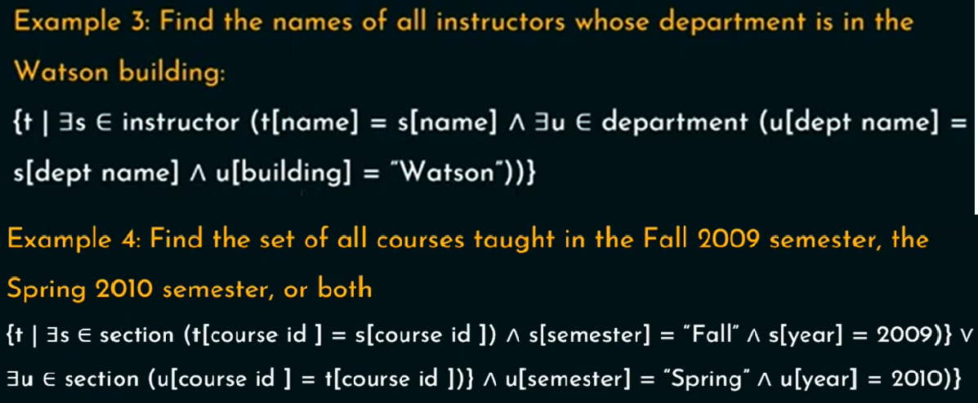

Slide 5
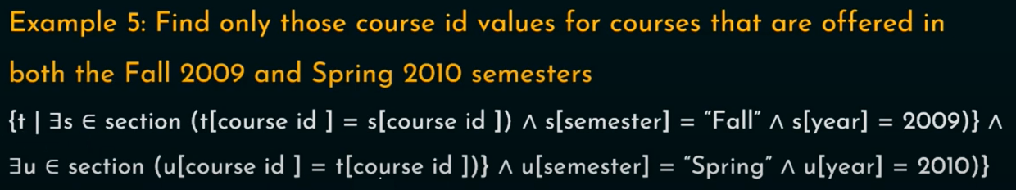
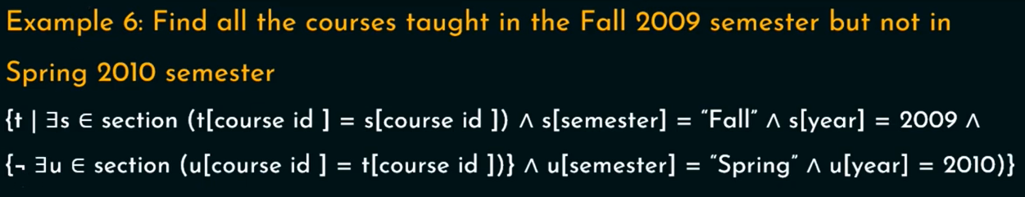

Slide 6
Exercise :
Consider the following relational database schema
Customer(cname, street, city)
Branch(Bname, Bcity)
Account(Accno, Bname, Balance)
Loan(Loanno, Branch, Amount)
Borrower(cname, Loanno)
Depositor(cname,Accno)
Use the above schema to answer the following query using Tuple Relational Calculus

Slide 8



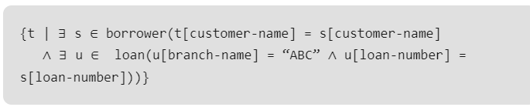
1
2
3
4

